Slide 1

Crime Data Analysis of Ontario Cities (2021-2024)
Presented by :
Sakshi Sandeep Salvi
Nitigya Vasudev
Mitali Sharma
Umang Sehgal
Prince Choudhary

Slide 2

Executive Summary
Purpose
Analyze and forecast crime trends across 5 Ontario cities
Dataset
Statistics Canada, filtered for actual incidents (2021–2024)
Techniques
EDA, clustering, t-tests, regression, exponential smoothing
Key Findings
Toronto reported the highest volume of crimes every year
Guelph and Windsor consistently reported the lowest crime levels
Crime levels are increasing year-over-year

Slide 3
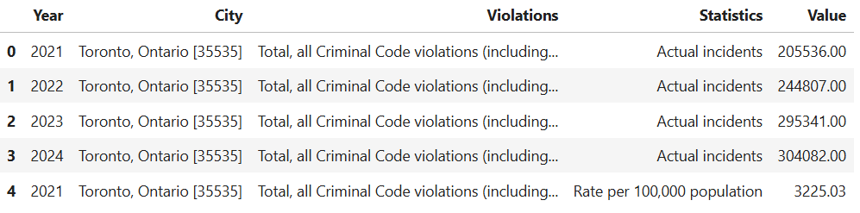
Data Cleaning & Preparation
Selected only “Actual incidents” from the raw dataset
Handled missing values and cleaned irrelevant rows
Final variables used
Year, City, Violations, Statistics, Value
Preprocessing steps
One-hot encoding for categorical variables
Normalized numeric features for clustering
Output
Clean, analysis-ready dataframe (CD_actual)

Slide 4
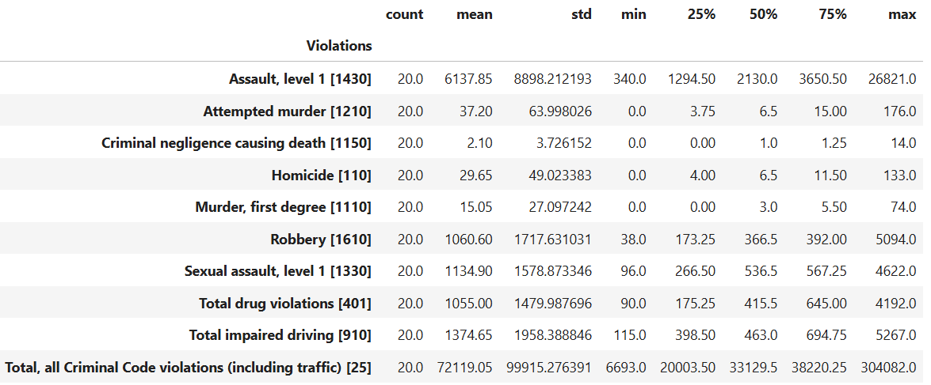
Descriptive Statistics
Key Insights –
Top Violations:
Assault, level 1 – highest avg (6,137), max 26,821
Sexual assault & Robbery – ~1,000+ avg incidents
Low-Frequency Crimes:
Homicide, Attempted murder, Negligence causing death – rare but serious
Total Crime:
Avg = 72,119 | Max = 304,082 (urban spike)
Variability:
High std devs = big city-wise differences
Skewed distribution with major outliers
Implication:
Resource allocation should focus on high-impact cities & violations

Slide 5

Data Visualization

Slide 6
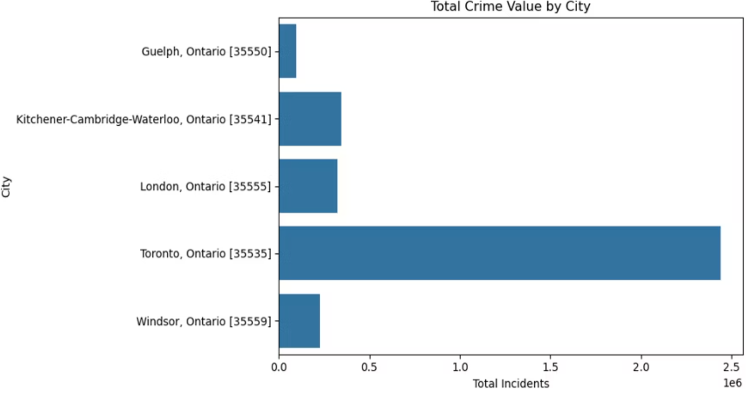
Total Crime Value by City (2021–2024)
Key Insights
Toronto recorded the highest total crime value, exceeding 2.4 million incidents across four years.
Kitchener–Waterloo and London reported mid-range crime volumes, indicating moderate urban crime activity.
Guelph had the lowest overall crime value, highlighting its relatively safer environment.
The sharp disparity between cities suggests that larger metropolitan areas experience significantly more crime.
These insights support city-specific planning, with more focus needed on high-crime urban centers like Toronto.

Slide 7
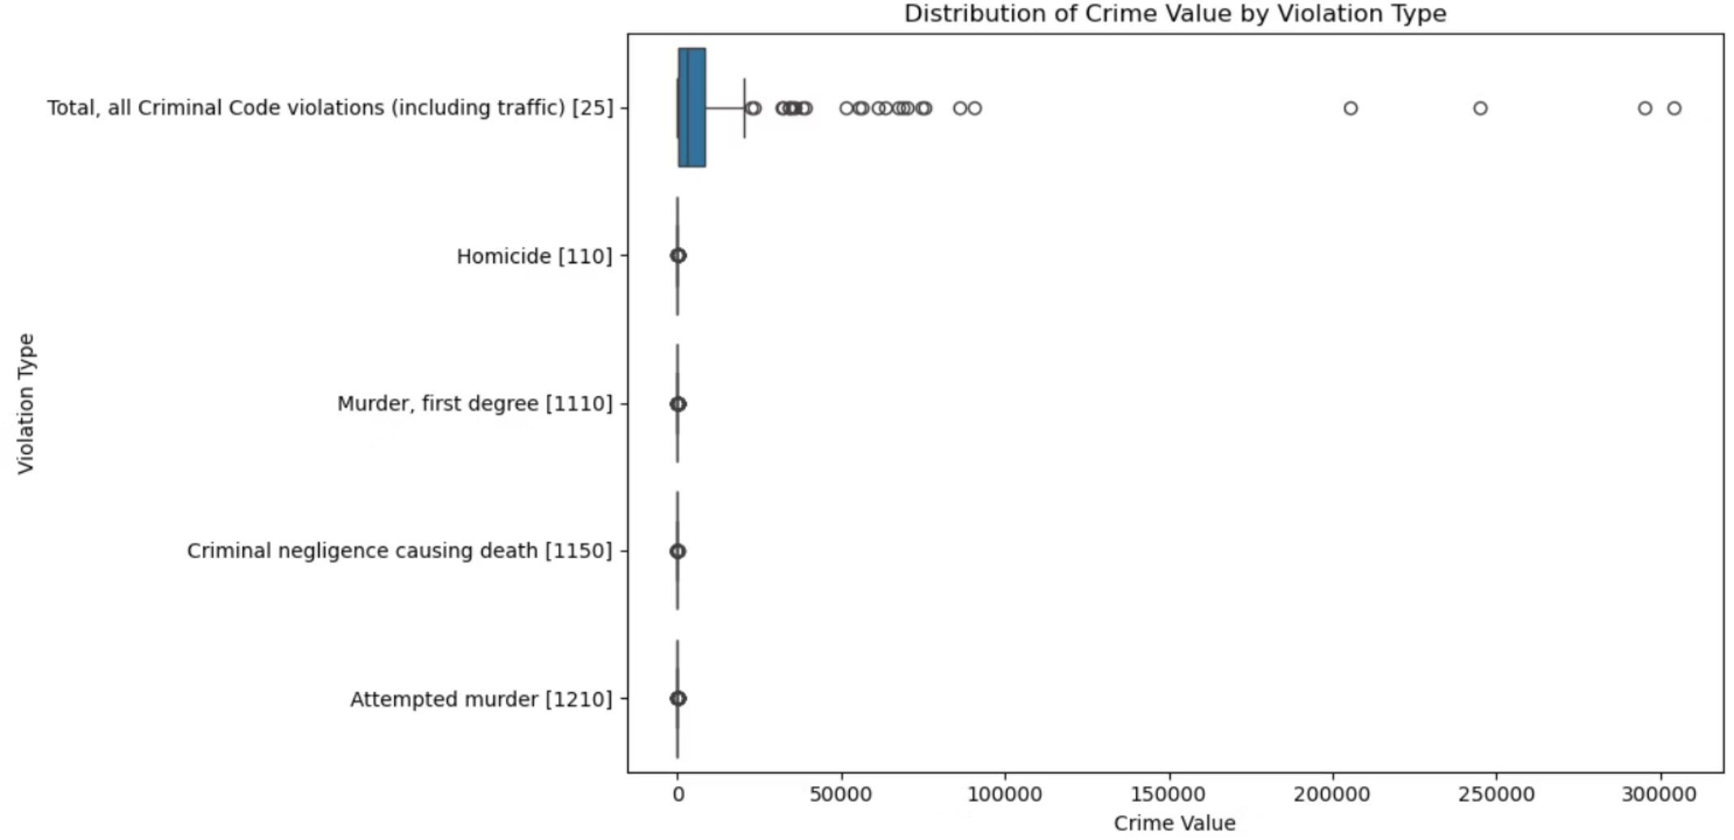
Distribution of Crime by Violation Type
Key Insights
Total Criminal Code violations show wide variance with multiple high outliers, indicating concentration in select cities.
Homicide, Murder, Negligence, and Attempted murder have consistently low values with a very narrow spread.
Most serious crimes occur infrequently and exhibit limited fluctuation across locations.
The chart highlights how frequent violations drive total crime volume, while violent crimes remain rare but impactful.

Slide 8
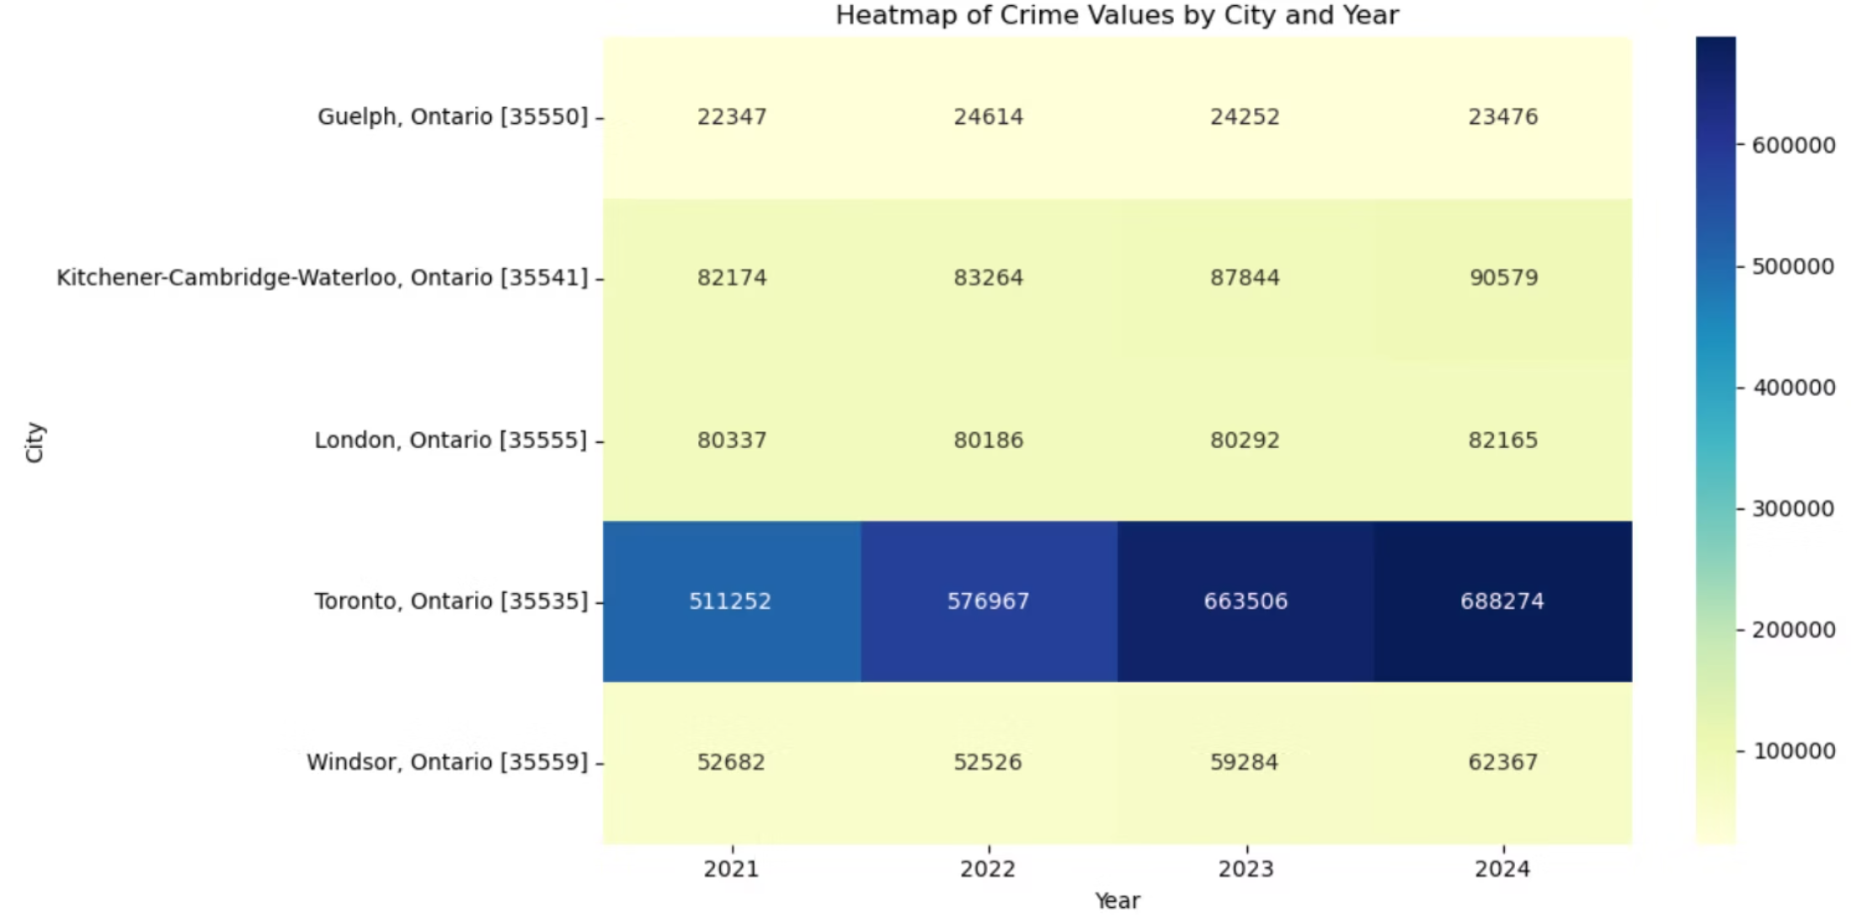
Heatmap of Crime Values by City and Year
Key Insights
Toronto consistently reports the highest crime values, rising steadily from 2021 (511k) to 2024 (688k).
Kitchener–Waterloo and London maintain moderate but stable crime levels over the years.
Guelph and Windsor remain the lowest crime cities, with only slight year-on-year increases.
The colour gradient emphasizes Toronto’s dominance in total crime volume annually.
The overall trend shows incremental crime growth across all cities from 2021 to 2024.

Slide 9
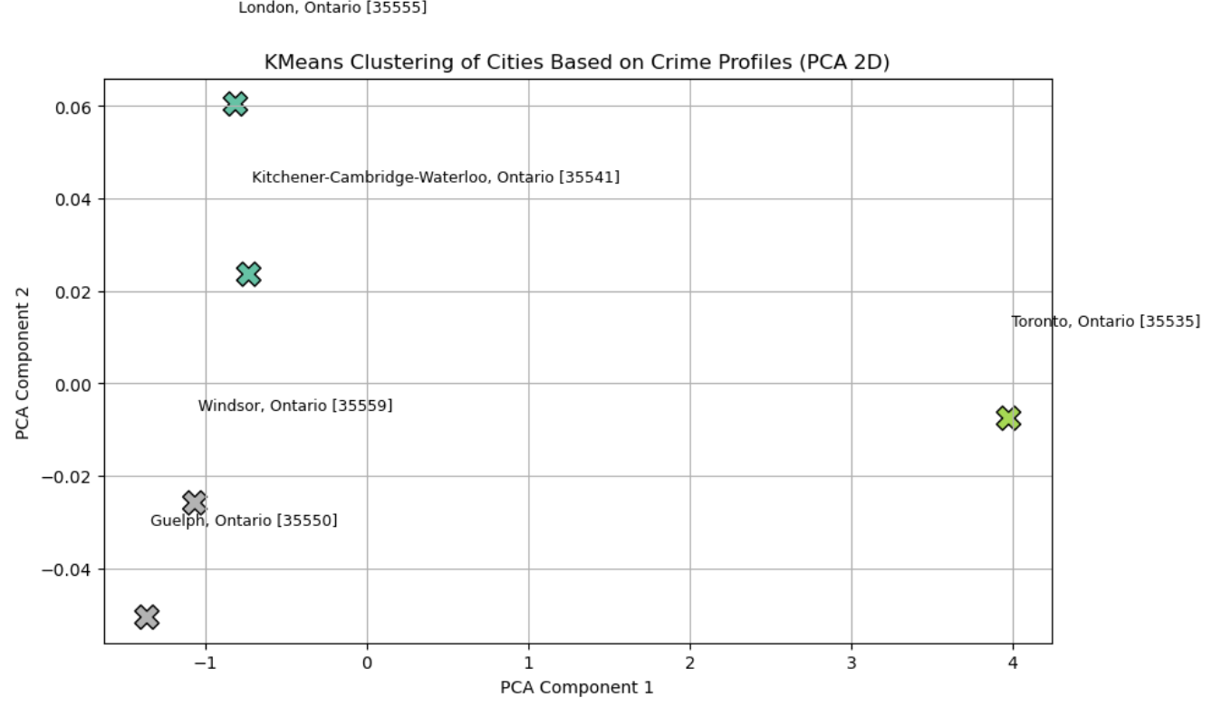
Clustering (Descriptive Data Mining)
Clustering:
K-Means is used to segment cities based on the total crime profile
PCA is used to reduce dimensions (visualized in 2D)
Key Insights
Toronto is clearly isolated, indicating a distinct crime profile—likely due to its high volume of incidents.
Kitchener–Waterloo and London are grouped, sharing similar mid-level crime patterns.
Guelph and Windsor cluster together, suggesting low and consistent crime levels.
Clustering helps segment cities for targeted policy or resource allocation based on crime behavior similarities.

Slide 10
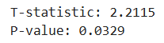
Statistical Inference
Hypothesis
Is there a significant difference in crime between Toronto and Windsor?
Method: Independent Samples t-Test
Compared actual incident values between Toronto and Windsor
t-statistic: 2.1115
p-value: 0.0329
Result
p < 0.05 → Statistically significant difference
Insights
The hypothesis test reveals a statistically significant difference in crime levels between Toronto and Windsor (p = 0.0329). This confirms that Toronto's higher crime rate is not due to chance but is meaningfully greater. The result suggests systemic or environmental factors contributing to elevated crime in Toronto that may not be present in Windsor.

Slide 11
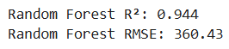
Regression & Predictive Modelling
Linear Regression
R² = -96.01 → Model fit is extremely poor
RMSE = 14,951
Struggled to handle categorical variables like City and Violations
Prediction: 33,093 incidents for Toronto, 2024 (Assault level 1)
Random Forest Regression
R² = 0.944 → Strong predictive performance
RMSE = 360.43
Effectively captured nonlinear relationships
Prediction: 25,183 incidents for the same input
Key Insight
Random Forest outperformed Linear Regression significantly, making it a more reliable model for forecasting crime counts across city, year, and violation dimensions.

Slide 12
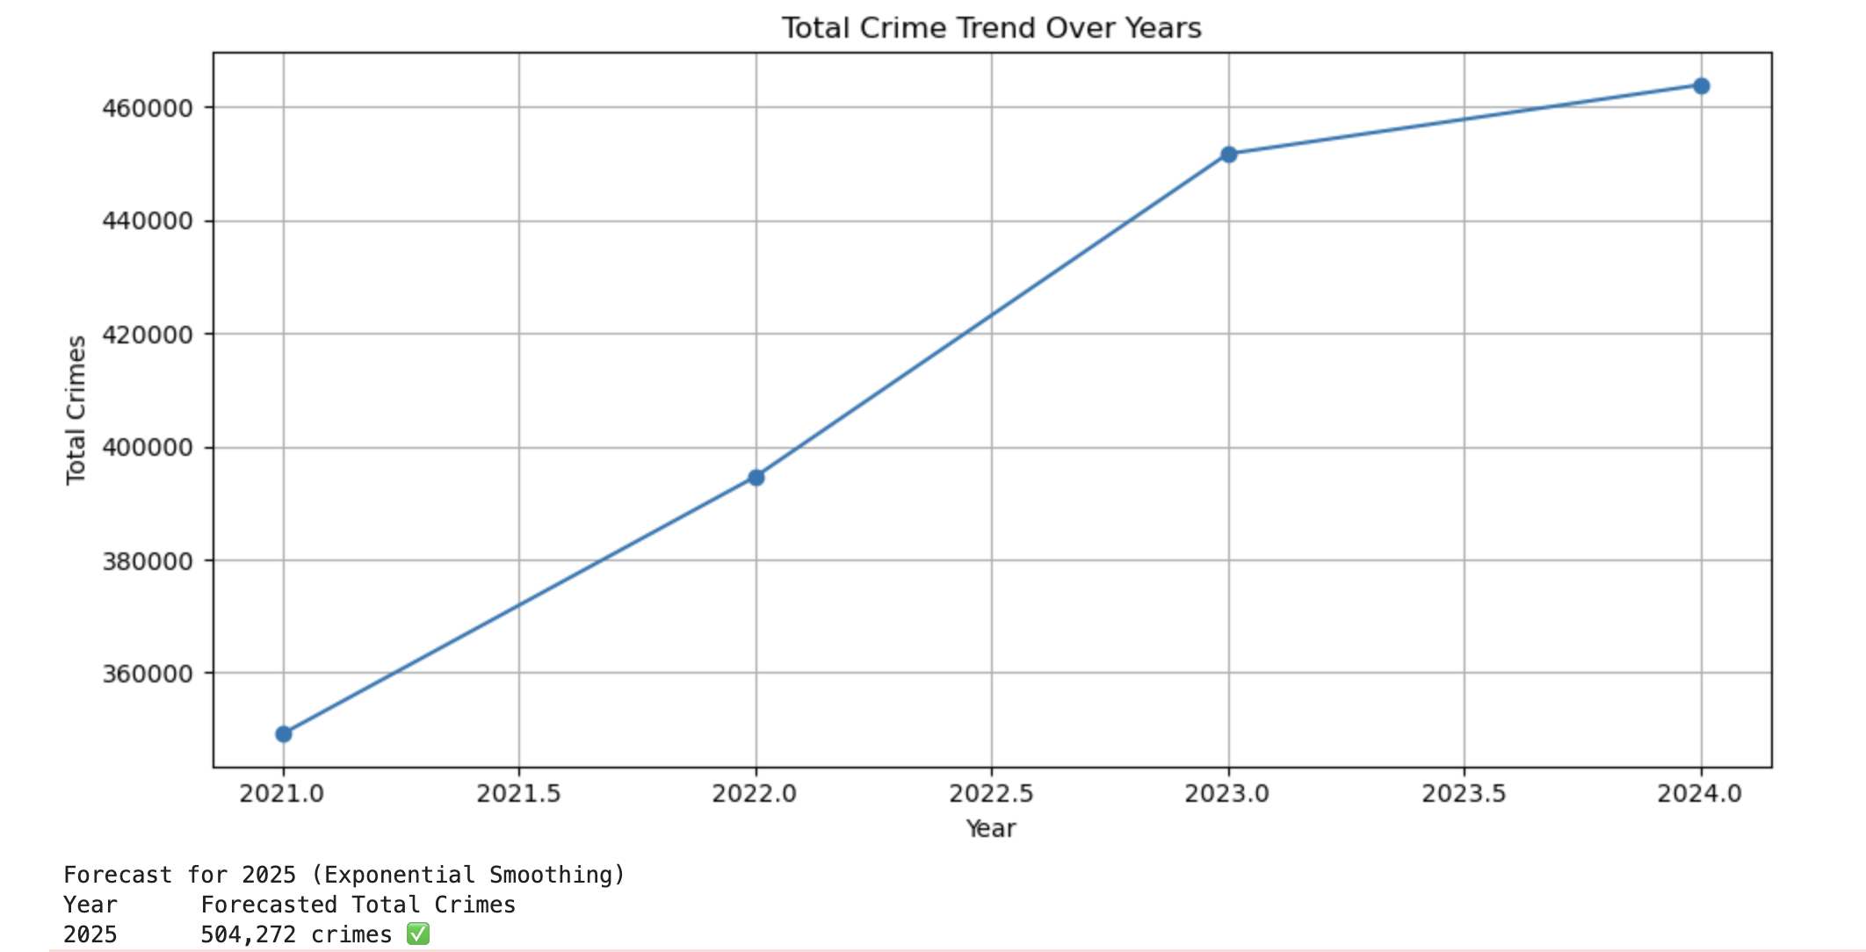
Time Series Forecasting
Methodology
Applied Exponential Smoothing on yearly crime totals (2021–2024)
Used trend-based modelling to forecast crime volume
Trend Insight
A clear upward trend is observed across 2021 to 2024
Indicates sustained growth in total reported crimes annually
Forecast for 2025
Predicted Total Crimes: 504,272 incidents
Suggests a further increase in 2025, reinforcing the need for preventive policy measures

Slide 13
Conclusion
The analysis of crime data from 2021 to 2024 across Ontario cities revealed that Toronto consistently had the highest crime levels, with assault and impaired driving as leading violations. Statistical testing confirmed that Toronto’s crime rate is significantly higher than Windsor’s, indicating real disparities in public safety. Predictive modelling showed that Random Forest Regression outperformed linear models, providing reliable forecasts, while time series analysis projected a continued rise in crime, estimating over 504,000 incidents in 2025. These insights highlight the need for targeted resource allocation in high-risk cities, proactive measures for top violations, and the integration of advanced analytics into crime prevention strategies to support data-driven policy and improve urban safety.

Slide 14
References
Government of Canada, Statistics Canada. (2025, July 22). Incident-based crime statistics, by detailed violations, Canada, provinces, territories, Census Metropolitan Areas and Canadian Forces Military Police. https://www150.statcan.gc.ca/t1/tbl1/en/tv.action?pid=3510017701
Data processed and cleaned in Python using Pandas, Matplotlib, Scikit-learn, and Statsmodels

Slide 15
RACI Chart
Task/Activity | Sakshi | Mitali | Nitigya | Umang | Prince
Data Collection & Cleaning | R | C | C | A | I
Exploratory Data Analysis (Descriptive Stats) | A | R | C | I | C
Data Visualization | A | C | R | C | I
Descriptive Data Mining (Clustering) | C | C | I | R | A
Statistical Inference (t-tests) | I | C | C | A | R
Regression Modeling | C | I | R | A | C
Time Series Forecasting | C | R | C | I | A
Report Writing (Executive Summary, Conclusion) | R | A | C | C | C
PowerPoint Creation | C | R | A | C | I
Final Review & Submission | R | C | A | I | C
Legend:
R = Responsible (executes the task) | A = Accountable (final decision-maker) | C = Consulted (provides input) | I = Informed (kept updated)

